Slide 1
LYNX RED LINE
Engineering Services for the
CATS North Corridor
Bus Rapid Transit Plan
RFQ# 2020-466
Charlotte Area Transit System (CATS)
June 5, 2020
Presented by AECOM Technical Services of North Carolina, Inc.

Slide 2
Presenters Introductions
Daniel Meyers, AICP
Project Manager
Mariate Echeverry
Deputy Project Manager
AECOM
31 Years of Experience
AECOM
23 Years of Experience
Julia Suprock, AICP
Planning Manager
Drew Joyner, PE, CPM
Public Engagement
Gavin Poindexter
Project Implementation
AECOM
15 Years of Experience
AECOM
25 Years of Experience
AECOM
14 Years of Experience
2

Slide 3
Agenda
BRT Experience/Case Studies
Alternative Analysis Approach
Community Engagement
Implementation Strategy
Why AECOM
Q&A

Slide 4
BRT Experience/Case Studies
PRESENTED BY
Daniel Meyers, AICP
Project Manager

Slide 5
The AECOM Team Believes a Successful BRT Project will…
Daniel Meyers, AICP
Project Manager
SPEAKER
Improve the Northern Communities’ connection from/to Charlotte
Align with the Regional Connect Beyond Plan
Strategically align with steps toward future transportation solutions
Support Community
Achieve Consent
Solve for the Future
Be Well Funded
Improve
Align
Support the Northern Communities’ growth goals
Achieve informed consent/buy-in from residents, area businesses and civic leaders as the next step
Align with a well-thought out aggressive funding plan
5

Slide 6
Project Organization
Daniel Meyers, AICP
Project Manager
SPEAKER
Mickey Geiser, PE
Technical Advisor
Daniel Meyers, AICP
Project Manager
Jeb Blackwell, PE
Engagement & Strategy
Mariate Echeverry
Deputy Project Manager
Julia Suprock, AICP
Planning Manager
Drew Joyner, PE, CPM
Public Engagement Manager
Bridget Moynihan, PE
Conceptual Design Manager
Gavin Poindexter
Project Implementation Manager
SUPPORT STAFF
Peer Review – Kayla Janowski
Ridership Forecasting – Pat Coleman
Station Area Planning – Jennifer McNeil Dhadwal
Urban Design – Auggie Wong, PLA (CMW)
Service Planning – Milbrey Heard, AICP (CTG)
O&M Costing – Nathan Barnett, AICP (CTG)
Active Transportation – John Cock (Alta)
Public Relations Specialist and Community Outreach – Cyndy-Yu Robinson
Digital Engagement – Ashley Bush
Online Engagement – Jim Meyer, AICP
Visuals – Sarah Bassett – Todd McAuliffe, AICP
Web Content – Joy Bailey
BRT – Jeff Koontz, PE
NCDOT – Ed Edens, PE
Interstate Design – Neil Dean, PE
Local Roads – Joe Lane, PE
Planning Coordination – Lauren Lynch
FTA Coordination / CIG Reporting – Brian Smart
SUBCONSULTANTS
Alta —
CMW —
CTG —
6

Slide 7
Extensive Experience in All Areas of BRT
Mariate Echeverry
Deputy Project Manager
SPEAKER
South Corridor BRT
Miami-Dade County, FL
Laker Line BRT Alternatives Analysis & Final Design
Grand Rapids, MI
East-West BRT Feasibility Study & Final Design
Milwaukee, WI
Silver Line BRT Streetscape Design & Utility Infrastructure
Grand Rapids, MI
Provo Orem Transportation Improvement Project
Utah County, UT
Dodge Street BRT Final Design
Omaha, NE
East-West Corridor BRT
Madison, WI
Scope Items
Project Management
+
+
+
+
+
+
+
Engineering
(Guideway, Structures, Station Design for BRT)
+
+
+
+
+
+
+
Ridership Modeling
+
+
+
+
+
+
Cost Estimating
+
+
+
+
+
+
+
Traffic Analyses
+
+
+
+
+
+
+
Public Involvement
+
+
+
+
+
+
+
FTA Pipeline/US DOT Funding
+
+
+
+
+
+
+
NEPA Class of Action Request
+
+
+
+
+
7

Slide 8
Relevant Project Experience
Gavin Poindexter
Project Implementation Manager
Mariate Echeverry
Deputy Project Manager
SPEAKER
SPEAKER
Understanding and experience at successfully delivering similar projects
CHAPEL HILL NORTH-SOUTH BRT
CHAPEL HILL, NORTH CAROLINA
ORANGE LINE/RED LINE HIGHWAY BRT
MINNEAPOLIS-ST. PAUL, MINNESOTA
SR 400 EXPRESS LANES
GEORGIA
SOUTHPARK COMPREHENSIVE NEIGHBORHOOD IMPROVEMENT PLAN
CHARLOTTE, NORTH CAROLINA
CHAPEL HILL NORTH-SOUTH BRT
CHAPEL HILL, NORTH CAROLINA
ORANGE LINE/RED LINE HIGHWAY BRT
MINNEAPOLIS-ST. PAUL, MINNESOTA
CATS LYNX SYSTEM UPDATE
CHARLOTTE, NORTH CAROLINA
SR 400 EXPRESS LANES
GEORGIA
RUSH LINE BRT
ST. PAUL, MINNESOTA
2
3
1
IMPLEMENTATION STRATEGY
DESIGN CHALLENGES AND SOLUTIONS
COMMUNITY ENGAGEMENT
8

Slide 9
Alternative Analysis Approach
PRESENTED BY
Julia Suprock, AICP
Planning Manager

Slide 10
???
Julia Suprock, AICP
Planning Manager
SPEAKER
What are the major challenges to reach a consensus on the ultimate goals of the project?
Challenge #1: Technical Issues
Challenge #2: Community Consensus
Guideway/infrastructure design
Service planning
Financial planning
Last mile(s)
Consistent, transparent, inclusive engagement
MEETING THE CHALLENGE #1
MEETING THE CHALLENGE #2
Segment the corridor to customize design and isolate key differentiators
Integrate feedback into design
10

Slide 11
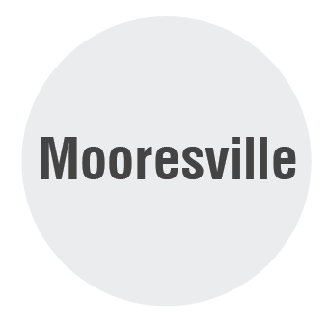
MOORESVILLE
Julia Suprock, AICP
Planning Manager
SPEAKER
???
1
MT. MOURNE
Mariate Echeverry
Deputy Project Manager
SPEAKER
What do the goals of this phase of the project need to portray, and what are the biggest challenges to achieve those goals?
2
DAVIDSON
PLANNING GOALS
3
CORNELIUS
Engaging and reflecting the community
Future proofing for the long term
Optimizing for federal funding
4
HUNTERSVILLE GATEWAY/ STUMPTOWN ROAD
5
GATEWAY STATION
11

Slide 12
Critical Considerations
Julia Suprock, AICP
Planning Manager
SPEAKER
1
MT. MOURNE
???
What are the critical issues?
2
DAVIDSON
Improve Northern Communities’ connection with Charlotte
Different markets, different users
Connections to/from the BRT
Support the Northern Communities’ growth goals
Context sensitive growth that reflects each community’s values
Align with the Regional Connect Beyond Plan
Integrate with and support existing plans
3
CORNELIUS
4
HUNTERSVILLE GATEWAY / STUMPTOWN ROAD
5
GATEWAY STATION
12

Slide 13
Planning Schedule
Julia Suprock, AICP
Planning Manager
SPEAKER
13

Slide 14
Implementation Plan
Julia Suprock, AICP
Planning Manager
SPEAKER
NEAR TERM
MEDIUM TERM
LONG TERM
BUILD
Improved Bus Service
Expanded Bike & Ped Access
North Corridor BRT
Construct Mobility Hubs
North Corridor Rail
Expand Mobility Hubs
PRESERVE
Assess community character
ID opps for affordable housing
Adapt to community character
Grow affordable housing
Evolve with community character
Preserve affordable housing
CULTIVATE
Listen to corridor communities
Plan TOD
ID funding sources
Achieve community consensus
Implement TOD
Secure funding sources
Envision long term investments
Grow TOD
Expand funding sources
14

Slide 15
Community Engagement
PRESENTED BY
Drew Joyner, PE, CPM
Public Engagement Manager

Slide 16
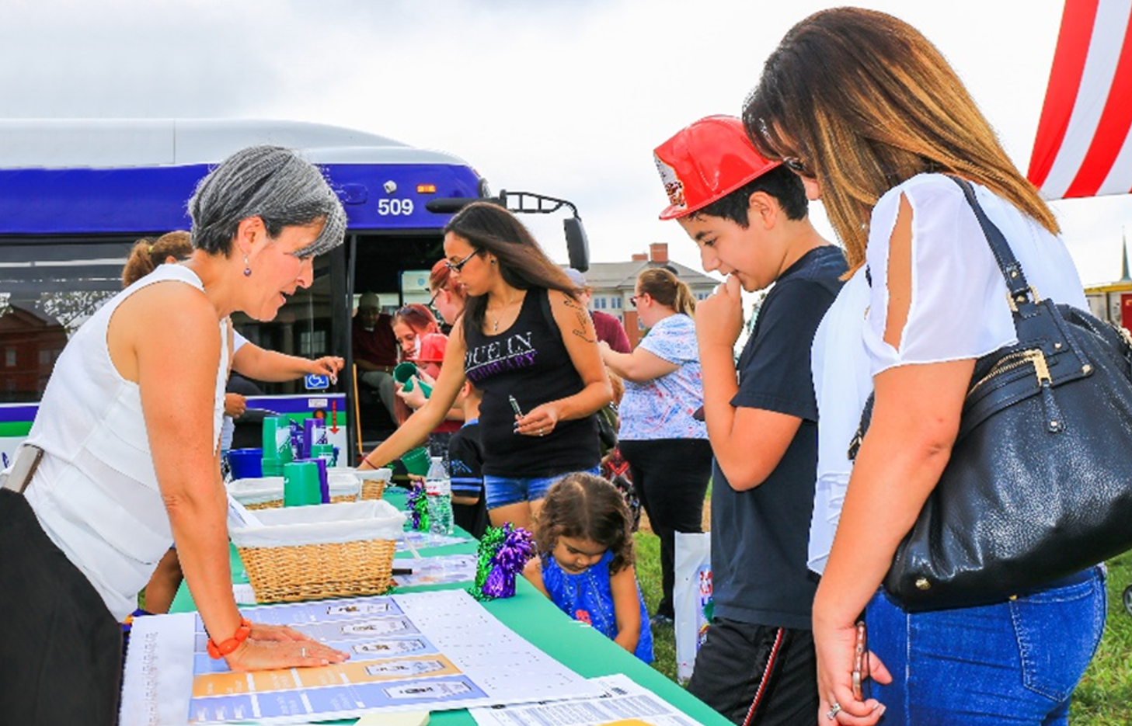
How we will increase public participation
Drew Joyner, PE, CPM
Public Engagement Manager
SPEAKER
Project Website
Web-based Tools
Local Partners
Pop-up Events
Project website and project hotline
Online techniques and social media​
Virtual open house meetings​
Online surveys/ outreach tools​
Social media outreach using geofencing​
Targeted outreach with key stakeholder groups/ representatives as advocates​
Partner with social service agencies, churches, community ambassadors and major employers​
Pop-up events utilizing social distancing protocols ​
Be flexible - build on what is effective for diverse communities​
16

Slide 17
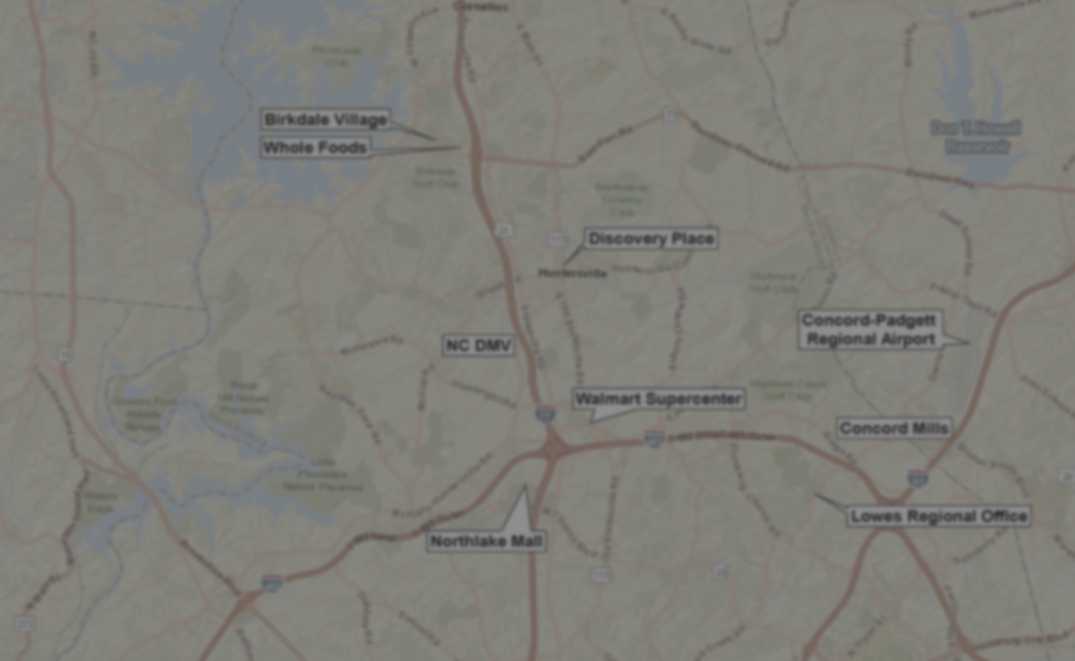
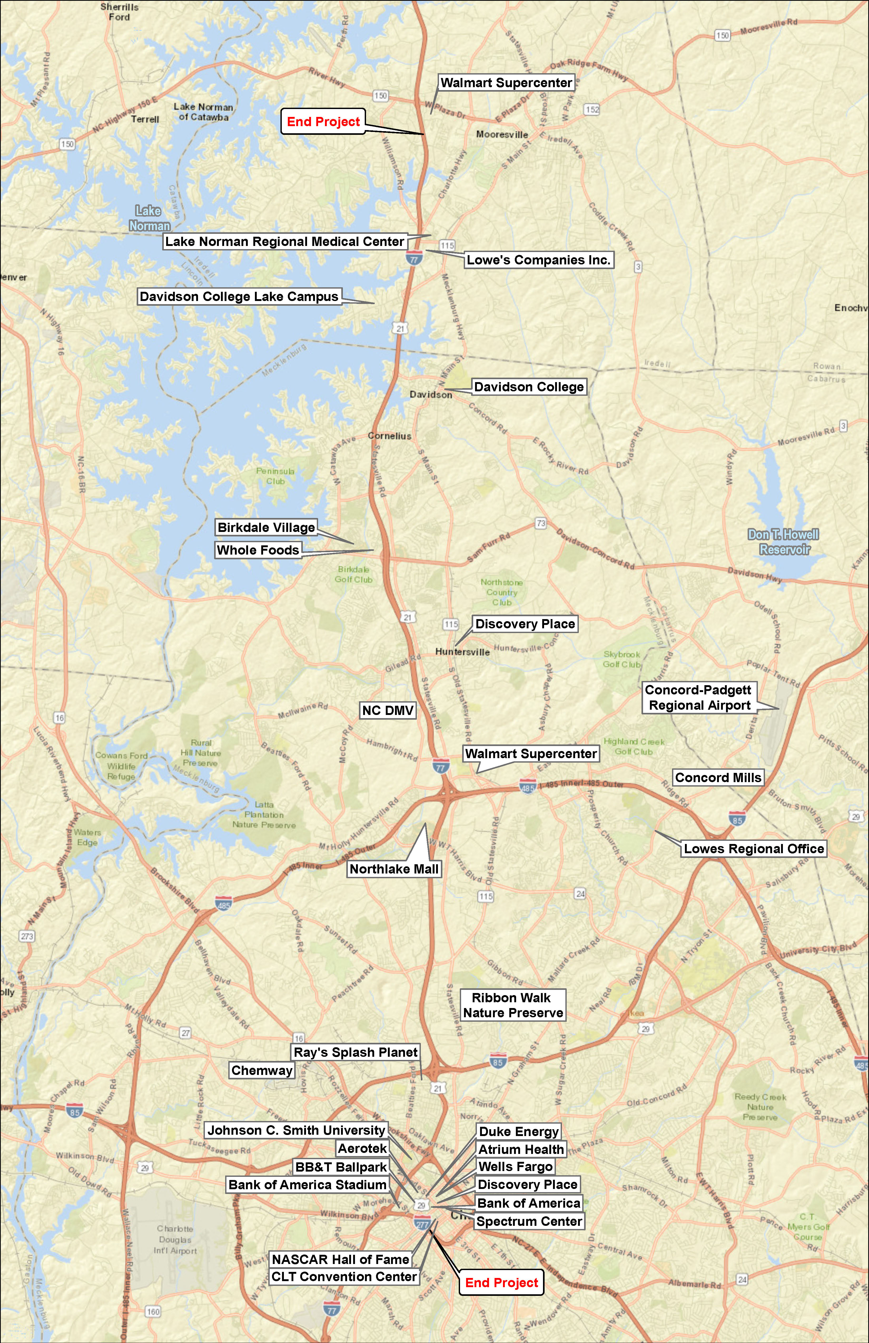
How we will build partnerships and seek public/private partnerships
Drew Joyner, PE, CPM
Public Engagement Manager
SPEAKER
POTENTIAL PARTNERS
Build on outreach with major employers to seek opportunities
Target businesses who will benefit from transit
Passbook program
Johnson & Wales Univ.
17

Slide 18
How we will increase public awareness and support for this project
Drew Joyner, PE, CPM
Public Engagement Manager
SPEAKER
Easily identifiable project branding combined with media/ social media campaign
Huge project kickoff with media/social media blitz
18

Slide 19
How we will achieve goals during social distancing
Drew Joyner, PE, CPM
Public Engagement Manager
SPEAKER
More online/virtual opportunities
Limit larger public meetings size
More small-group/ pop-up/one-on-one outreach
19

Slide 20
Public Engagement — Planning for Success
Drew Joyner, PE, CPM
Public Engagement Manager
SPEAKER
THE AECOM TEAM COMMITMENT
We are committed to providing expert guidance to the project team on a creative, agile and effective public engagement program.
20

Slide 21
Implementation Strategy
PRESENTED BY
Gavin Poindexter
Project Implementation Manager

Slide 22
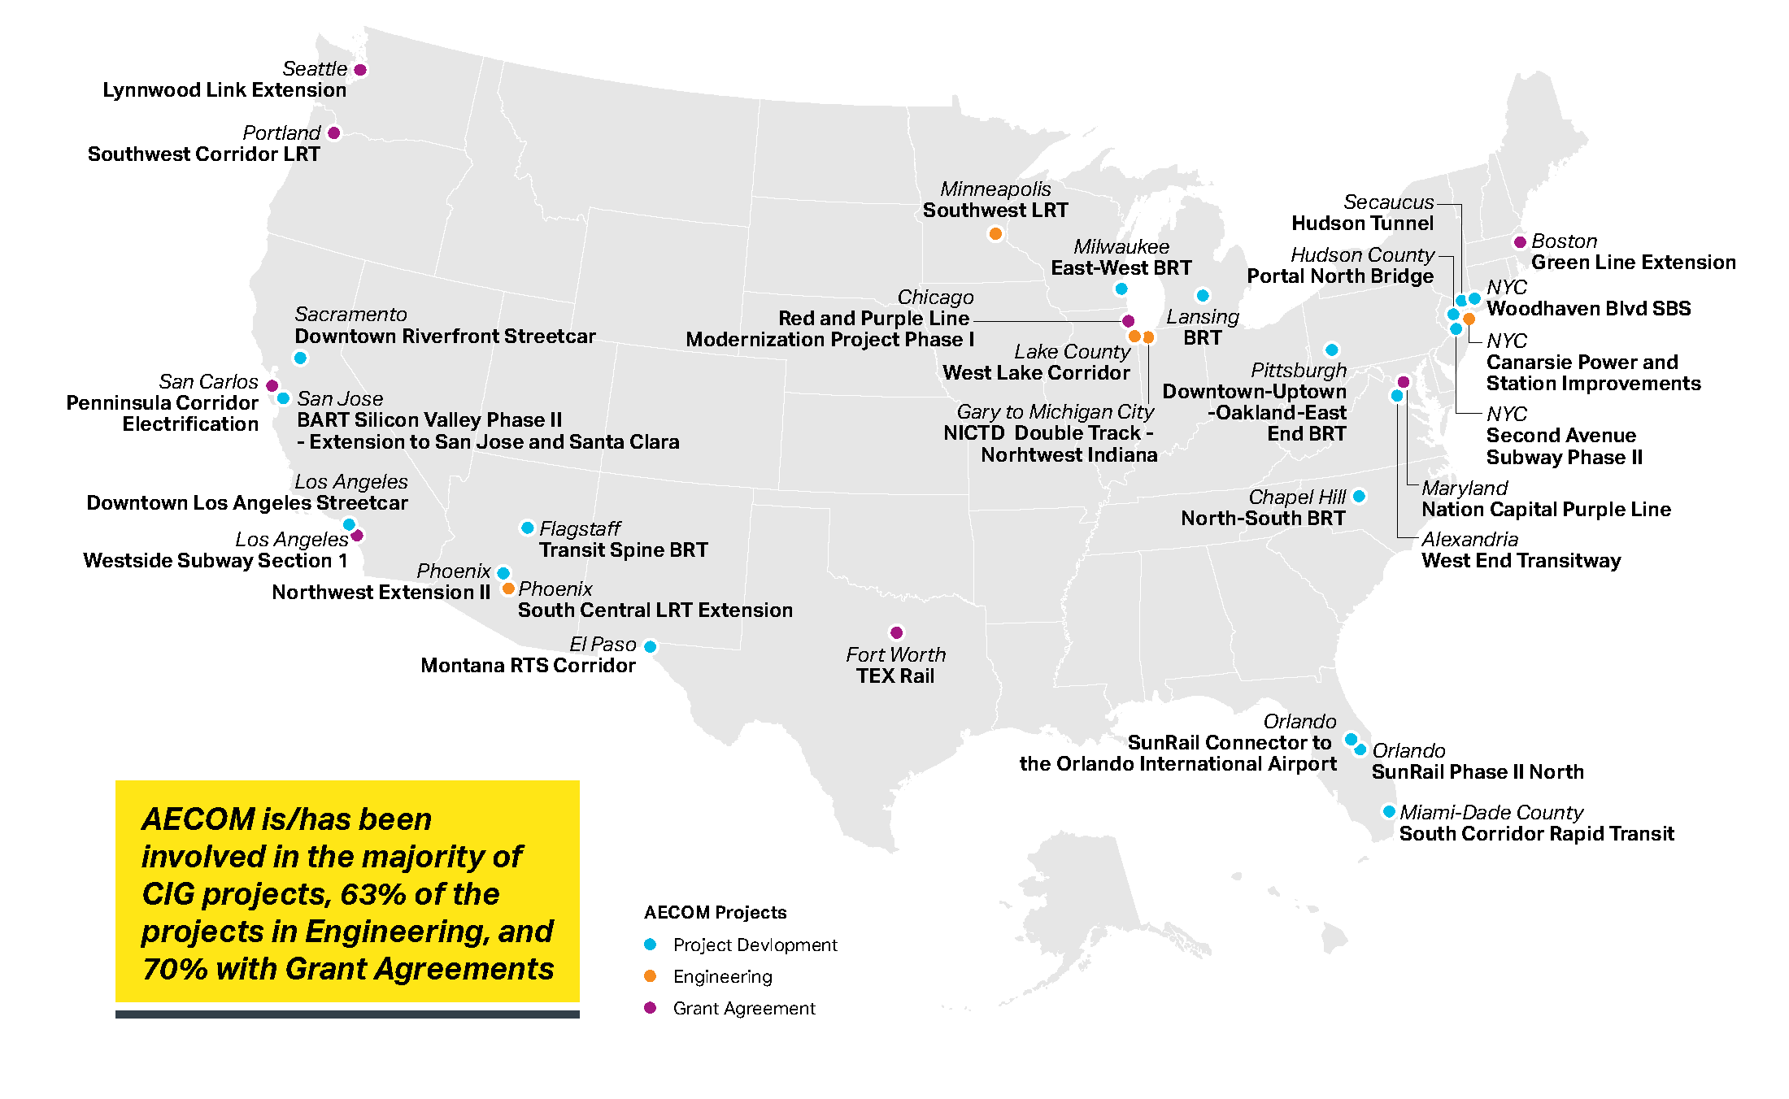
Implementation Strategy – Full Implementation
Gavin Poindexter
Project Implementation Manager
SPEAKER
Capital Investment Grant (CIG) Program
AECOM Projects
Project Development
Engineering
Grant Agreement
22

Slide 23
Implementation Strategy – Full Implementation
Gavin Poindexter
Project Implementation Manager
SPEAKER
Typical Small Starts Process
PROJECT SCHEDULE
DESIGN
30%
60%
100%
2017
2018
2019
2020
2021
2022
2023
2024
PROJECT FUNDING
FTA PROJECT DEVELOPMENT
Adopt LPA
Request Entry into PD COA Request
Adopted into LRTP
Granted Entry to PD
Request Rating
Grant Award / End of PD
Grant App
ENVIRONMENTAL
NEPA
23
23

Slide 24
Implementation Strategy – Full Implementation
Gavin Poindexter
Project Implementation Manager
SPEAKER
PROJECT EXAMPLE — LESSONS LEARNED
Miami-Dade South Corridor BRT
PROJECT SCHEDULE
DESIGN BUILD
30%
DESIGN- BUILD
2017
2018
2019
2020
2021
2022
2023
2024
PROJECT FUNDING
FTA PROJECT DEVELOPMENT
Adopt LPA
Request Entry into PD COA Request
Adopted into LRTP
Granted Entry to PD
Request Rating
Grant Award / End of PD
ENVIRONMENTAL
NEPA
24
24

Slide 25
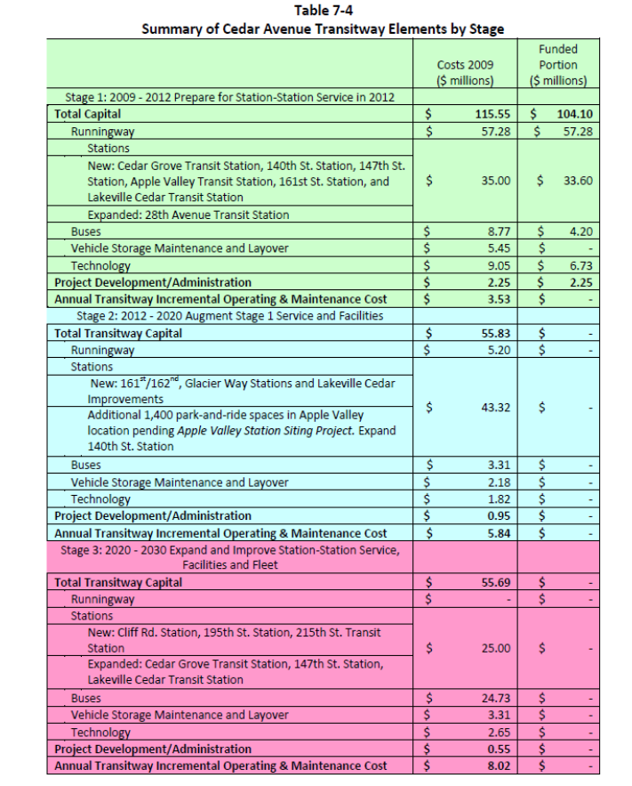
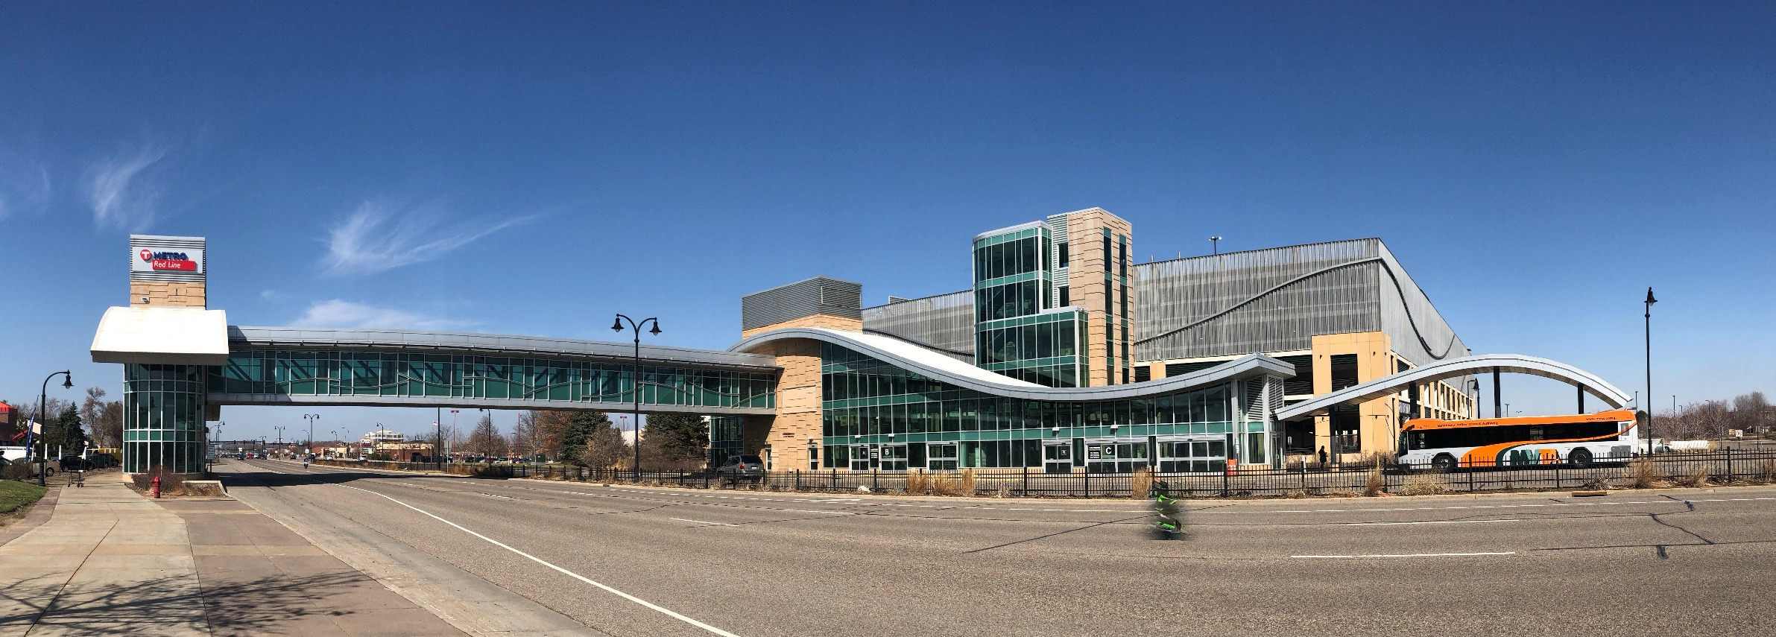
Implementation Strategy – Phased Implementation
Gavin Poindexter
Project Implementation Manager
SPEAKER
PROJECT EXAMPLE — LESSONS LEARNED
Red Line BRT in Twin Cities
Develop a vision for the corridor
Separate vision into projects with independent utility
Separate project elements by potential funding source
Identify low hanging fruit and deliver to show success and commitment
25

Slide 26
Red Line BRT – Implementation Strategy
Gavin Poindexter
Project Implementation Manager
SPEAKER
Designing for Growth
26

Slide 27
Red Line BRT - Implementation Strategy
Gavin Poindexter
Project Implementation Manager
SPEAKER
Growing system as demand increases
Integrated into their environment
27

Slide 28
Implementation Strategy – Funding Sources
Gavin Poindexter
Project Implementation Manager
SPEAKER
FEDERAL
STATE
LOCAL
Discretionary (e.g. Small Starts, BUILD, Buses and Bus Facilities)
Formula (e.g. FTA and FHWA formula funds)
SPOT
Sales tax
Property taxes
Special taxing district
General fund
Vehicle registration
28

Slide 29
Implementation Strategy – Opportunities and Challenges
Gavin Poindexter
Project Implementation Manager
SPEAKER
www.twitter.com
Opportunities fund individual project elements
Identify project elements with independent utility
Davidson Station
Future federal discretionary grant
Challenges with funding project
FTA CIG program
COVID-19
NCDOT shortfall
Annual operating funding
29
Notes:
Ride with Rusty, (Rusty Knox)

Slide 30
We Want to Work with YOU!
Daniel Meyers, AICP
Project Manager
SPEAKER
WHAT SETS US APART
ADVANTAGES TO CATS BRT
Experienced team
Multi-discipline team
Thorough understanding of needs
Innovative approach
We get our clients’ projects delivered
You can trust the job will be done right!
Smooth working relationships and coordination of project
Flexible solutions tailored to the Towns’ and Counties’ needs
Quick response from our team
The AECOM Team
Experience and Innovation make the Difference
30

Slide 31
Questions?
Daniel Meyers, AICP
Project Manager
SPEAKER
CHAPEL HILL NORTH-SOUTH BRT
CHAPEL HILL, NORTH CAROLINA
LAKER LINE BRT ALTERNATIVE ANALYSIS & FINAL DESIGN
GRAND RAPIDS, MICHIGAN
SILVER LINE BRT STREETSCAPE DESIGN & UTILITY INFRASTRUCTURE
GRAND RAPIDS, MICHIGAN
EAST-WEST BRT FEASIBILITY STUDY & FINAL DESIGN
MILWAUKEE, WISCONSIN
SOUTH CORRIDOR BRT MIAMI-DADE COUNTY, FLORIDA
“Thank you for your outstanding work. I know we have selected the best team for this study. Your technical expertise paired with ability to relate to different stakeholder groups helped move this study along and got us to the adopted LPA.”
-Matt Cecil, Chapel Hill Transit
“Well-informed, experienced, and organized team stayed on schedule and facilitated the planning process very effectively. Effective and organized communication and the team took the initiative to stay on top of all project components.”
- Nick Monoyios, The Rapid
“Qualified management and
competent BRT technical staff; attentive to client needs; engaged, accommodating, and willing to help; flexible and quick in adjusting to scope changes.”
- Jie Bian, Miami-Dade County Department of Transportation and Public Works
“The Silver Line Bus Rapid Transit project has proven to be very successful. [AECOM] They provided a great team, great communication, and outstanding guidance throughout the project and are certainly experts on both determining, and advancing, BRT projects.”
- Conrad Venema, The Rapid
“The AECOM East-West BRT Team has been extremely responsive to project requirements and gone above and beyond in catering to the requirements of Milwaukee County.”
- John Rodgers, Milwaukee County Department of Transportation
31

Slide 32
Thank you.
AECOM Technical Services of North Carolina, Inc.

